Slide 1
INTRODUCTION
Bitcoin is an online virtual currency which is already being used based on public key cryptography.
proposed in 2008 in a paper written by someone named Satoshi Nakamoto as pseudonym.
It is fully working from January 2009 and its broad acceptance, simplified by the presence of exchange markets allowing easy changing with conventional currencies (EUR or USD)

Slide 2
Background
Fiat currency and Bitcoin
Fiat currency is legal tender whose value is backed by the government that issued it. The U.S. dollar is fiat money, as are the Euro, Taka and many other major world currencies.

Slide 3
Fiat currency vs Cryptocurrency
Is Bitcoin a Fiat Currency?
Why Bitcoins have values?
Why Bitcoins have values?
BITCOIN IS LIKE GOLD!

Slide 4
Prototype of Bitcoin
How Bitcoin mining works?
Fixed 21million bitcoin set up by the core developers.
When Bitcoin miner's does mining(solves algorithms) they get rewards as Bitcoin from the core developers.
So basically we can see that the miners share their resources to solve algorithms and for the rewards they get bitcoins from the core developers.

Slide 5
How to Store Bitcoin
Cold storage is an offline wallet provided for storing bitcoins. With cold storage, the digital wallet is stored on a platform that is not connected to the internet, thereby, protecting the wallet from unauthorized access, cyber hacks, and other vulnerabilities that a system connected to the internet is susceptible to.

Slide 6
Where does the math problem comes from?
It was given by the core developers (As per our findings)!
The more people joins the bitcoin network the more difficult the algorithms become to solve
So the Miners uses a pool method to solve the problem.

Slide 7
What is the Resources of Bitcoin?
As per our initial finding we can say that the resource of our bitcoin is 21million BTC. Which is a fixed amount set up by the core developers who developed the bitcoin.

Slide 8
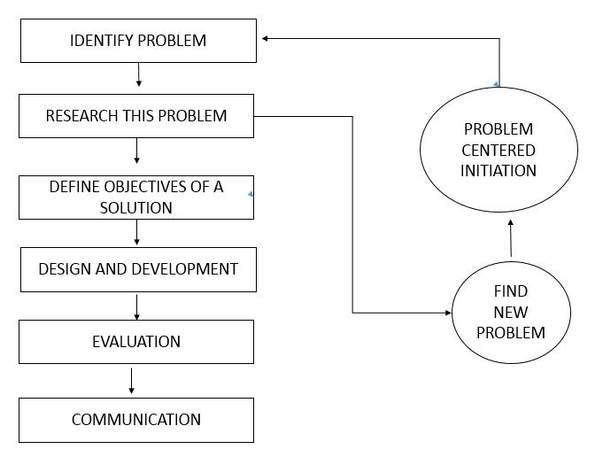

Slide 9
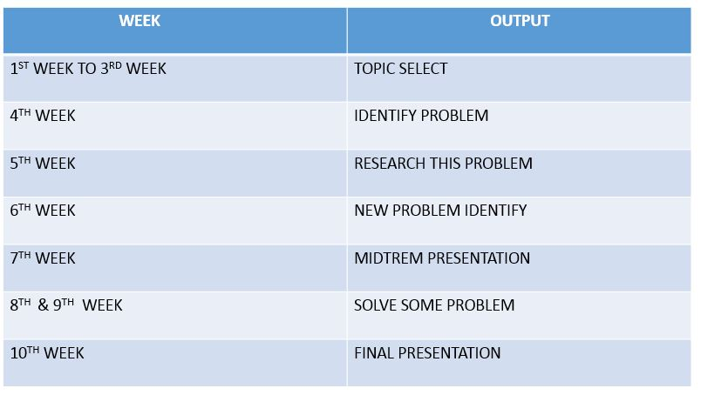

Slide 10
Results

Slide 11
Discussion

Slide 12
Conclusions

Slide 13
Future works

